Slide 1
AUTOMATIC COLLEGE BELL
Group 2
4M20EE022 | DISHA RAVI |  | 4NM20EE032 | KANZAL HAQ
4NM20EE038 | M. SATWIK RAI

Slide 2
Introduction
Our Project takes over the task of Ringing of the Bell in Colleges. It replaces the Manual Switching of the Bell
When this time equals to the Bell Ringing time, then the Relay for the Bell is switched on.
The Bell Ringing time can be edited at any Time, so that it can be used at Normal Class Timings as well as Exam Times.
The Time Clock is displayed on LCD display. The Microcontroller 8051 is used to control all the Functions, it get the time through the keypad and store it in its Memory.
The time and Bell time get equal then the Bell is switched on for a predetermined time

Slide 3
Problem Definition
To design automatic college bell using 8051 microcontroller
Alarm Clock and some bells that ring after some time intervals and that cannot stop after specific time, musical clock can be taken as an example
All these limitations have been removed by our project.
It rings only according to our college time table that can be set using the 8051 microcontroller

Slide 4
Objectives
To learn the working of the automatic college bell and the role of 8051 microcontroller in its implementation.
To study the controller model and its performance
Operated using a microcontroller where the college bell is operated fully automatic and doesn’t requires any manpower
More accurate than the one which is operated manually.
It replaces the manual switching of the bell in the college

Slide 5
COMPONENTS
CRYSTAL (11.059 MHZ ,32.768KHZ)
DIODE(1N4700)
RELAY SWITCH (5V MAGNETIC RELAY)
8051 MICROCONTROLLER
BELL
RESISTORS (8,2,10,1) KΩ,330E
TRANSISTOR (BC 557) PNP
CAPACITORS (1000µF ,10µF , 140pf)
DISPLAY(16×2 LCD)
PUSH BUTTONS

Slide 6
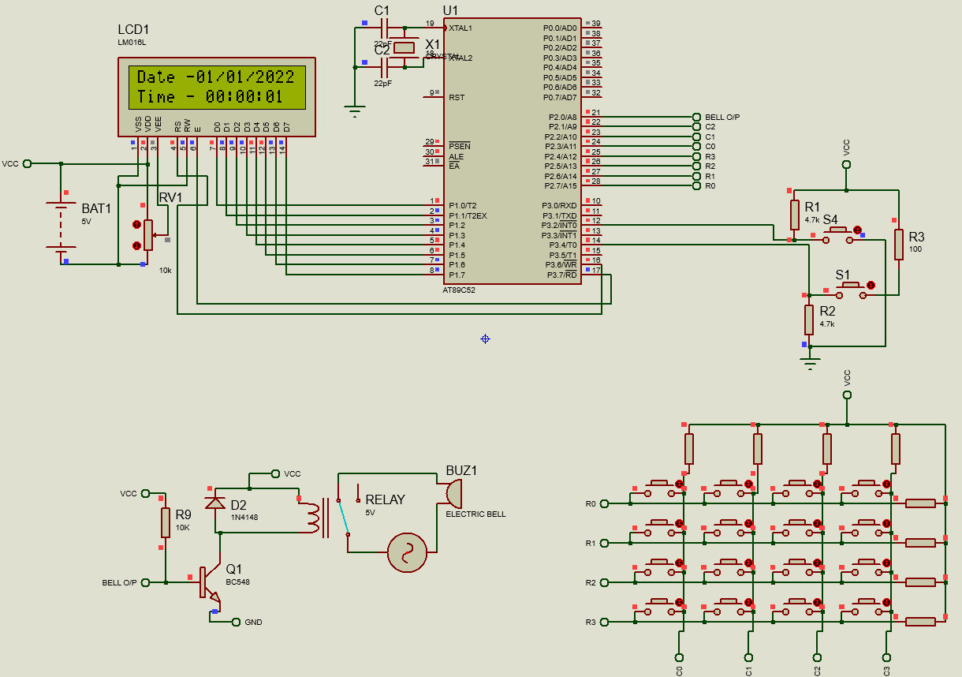
CIRCUIT DIAGRAM

Slide 7
Project Implementation
This system demonstrates a simple configuration of a circuit of automatic college bell using Microcontroller 8051 which is designed so as the bells in the colleges are not to be operated manually and are fully automatic
Once data is entered the college bell rings after a regular interval as per the programmers need and the timing may be varied in between to include breaks.

Slide 8
Results and Discussion
The bell which can be for desired interval of its functioning as per expected
The timing of the bell can be varied using the keypad supplied with it
The time is displayed in the led screen
The variation in timing is also applicable and is used in this circuit

Slide 9
Conclusion
A automatic college bell can be successfully designed and can be applicable in school and colleges as per to save manpower
To save time it’s a cost effective project which can be built using easily available equipment and can be used in real time in the school and in the colleges
This can be included in every educational institution as per the timing which can be easily reprogrammed by a common laymen and can also vary timing for some classes as per the schedule of the school.
The display of time in the project also increases it effectiveness.

Slide 10
References
Textbooks
8051 microcontroller and embedded systems by mazidi and mazidi
Applied electronics by R.S sedha
Web materials
www.alldatasheet.com
www.8051projects.com

Slide 11
Thank You

